Slide 1


RESTAURANT MANAGEMENT
ANALYSIS
ARPIT SHARMA
JAN-24

Slide 2
AGENDA
INTRODUCTION
ABOUT ZOMATO
ANALYTICAL APPROACH AND TOOLS
DASHBOARD AND VISUALISATIONS
CONCLUSION

Slide 3
INTRODUCTION
Purpose of Presentation:
Analyze key market factors for new restaurant openings.
Identify optimal locations for restaurant expansion.
Provide strategic recommendations based on data analysis.
Explore factors such as average cost, ratings, and restaurant density.
Align growth objectives with market demand and customer expectations.

Slide 4

ABOUT ZOMATO
An Overview
Founded: 2008 by Deepinder Goyal and Pankaj Chaddah in India.
Initial Focus: Started as Foodiebay, a restaurant discovery platform.
Rebranding: Renamed to Zomato in 2010.

Slide 5
Key Milestones:
Global Expansion: Expanded to over 24 countries and more than 10,000 cities.
Acquisitions: Acquired multiple companies to enhance its service offerings, including Uber Eats India in 2020.
IPO: Went public in 2021, marking a significant milestone in its growth.
Core Services:
Restaurant Discovery: Comprehensive database for discovering restaurants, cafes, and bars.
Online Food Delivery: Facilitates food ordering and delivery through its app and website.
Table Reservations: Allows users to book tables at their favorite restaurants.
User Reviews and Ratings: Provides a platform for customers to review and rate dining experiences.
Zomato Gold: Membership program offering exclusive dining privileges and discounts.

Slide 6

Data snapshot
Global Restaurant Count: 9,551 restaurants worldwide
Number of Countries Covered: Operations in 15 countries
Variety of Cuisines Offered: 1,825 different types of cuisines globally
Indian Market Presence: Active in 43 cities across India, demonstrating extensive reach

Slide 7
Analytical approach & tools
Data Cleaning: Applied functions like FIND, REPLACE, and IF to ensure data accuracy and address missing values.
Data Enrichment: Enhanced the dataset by adding new variables using VLOOKUP and XLOOKUP to fetch relevant data.
Descriptive Analysis: Used Pivot Tables to summarize key metrics and identify distribution patterns across various regions and cuisine categories.
Visualization: Developed dynamic charts and dashboards for data representation, facilitating interactive data exploration.

Slide 8
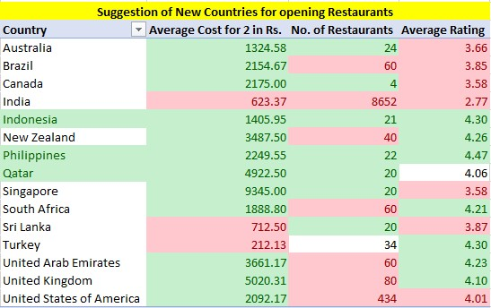
Suggested countries to open new restaurants
Selected Countries: Indonesia, the Philippines, and Qatar.
High Average Ratings: Above the median rating of 2.89, indicating strong customer satisfaction and a positive dining culture.
Healthy Number of Restaurants: Above the median number of 34 restaurants, suggesting a thriving market with ample demand.
Higher Spending Capacity: The average cost for two is above the average of 809, indicating markets where customers value quality and are willing to spend more for premium dining experiences.

Slide 9
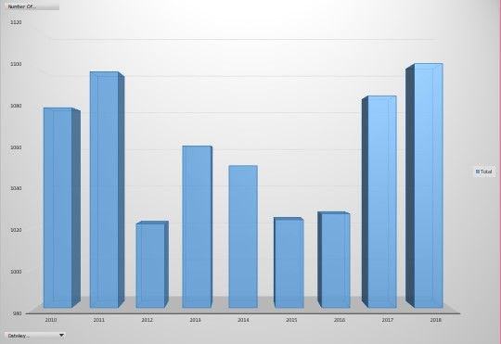
Restaurants opened each year
2011 and 2012 Peak: The highest number of restaurants was recorded in these years, indicating a peak in restaurant openings or data collection.
Mid-Year Decline: A noticeable decline in the number of restaurants from 2013 to 2016, suggesting potential market saturation, economic downturn, or changes in data collection methods.
Recovery in 2017: An increase in the number of restaurants, indicating market recovery or expansion efforts.
Strong Performance in 2018: The number of restaurants reached a peak similar to 2011 and 2012, showing strong market conditions or successful business strategies.
Fluctuations: The data exhibits significant year-on-year fluctuations, which could be influenced by various market dynamics, regulatory changes, or shifts in consumer preferences.

Slide 10
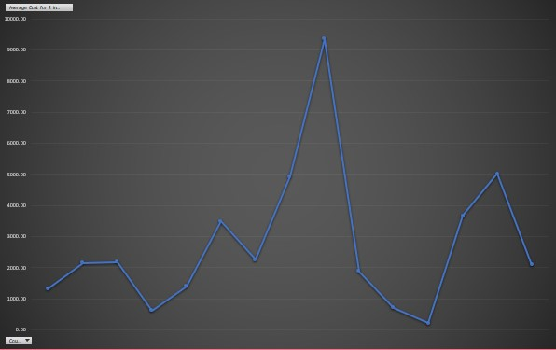
The average cost for two in each country
High-Cost Variability: Dining costs for two people vary widely across countries.
Affordable Countries: Some countries have notably lower dining costs.
Pattern Observation: Alternating high and low costs suggest regional economic differences.
Traveler Budgeting: Helps travelers plan dining budgets by country.
Business Strategy: Useful for restaurants to set pricing strategies internationally.

Slide 11
biggest competitors
NAME | COUNTRY | STATE/CITY | RATING | AVERAGE COST FOR 2 PERSONS
Talaga Sampireun | Indonesia | Jakarta | 4.9 | ₹1000
Skye | Indonesia | Jakarta | 4.1 | ₹4000
Toodz House | Indonesia | Jakarta | 4.6 | ₹825
Zaffran Dining Experience | Qatar | Doha | 4.6 | ₹6600
MRA Bakery Sweets & Restaurant | Qatar | Doha | 4.0 | ₹1320
Silantro Fil-Mex | Philippines | Pasig City | 4.9 | ₹1120

Slide 12
Strategic recommendations
Target Markets:
Indonesia (Jakarta)
Qatar (Doha)
Philippines (Pasig City or Pasay City)
Market Selection Criteria:
High Customer Satisfaction: Countries with average ratings above the median of 2.89.
Robust Market Demand: Countries with a number of restaurants above the median of 34, indicating a thriving market.
Higher Spending Capacity: Focus on markets where the average cost for two exceeds 809, indicating a willingness to spend more on premium dining experiences.
Operational Strategies:
Quality Focus: Maintain high standards of food quality and service to meet and exceed customer expectations.
Premium Pricing: Set prices slightly above average to align with the spending capacity and perceived value in selected markets.
Culinary Variety: Offer a diverse menu to cater to a broad range of tastes and preferences.

Slide 13
Market Penetration:
Leverage Positive Ratings: Use existing high ratings to build brand reputation and attract new customers.
Optimize Restaurant Locations: Choose strategic locations within the selected cities to maximize visibility and customer footfall.
Data-Driven Decisions:
Continuous Monitoring: Regularly analyze market trends and customer feedback to adapt strategies as needed.
Visual Data Representation: Utilize tools like box plots and scatter plots to track performance and identify areas for improvement.
Minimal Focus on Online Delivery:
India Exception: Limited data outside India and low average ratings for online delivery in India (2.8) suggest minimal impact on customer satisfaction.
Focus on Dine-In Experience: Prioritize enhancing the in-restaurant dining experience over expanding online delivery services.
Adapt to Local Preferences:
Location-Based Pricing: Adjust the rates of certain cuisines based on the specific location to maximize profitability.
Cultural Sensitivity: Tailor restaurant themes and menus to align with local cultural preferences and dining habits.

Slide 14
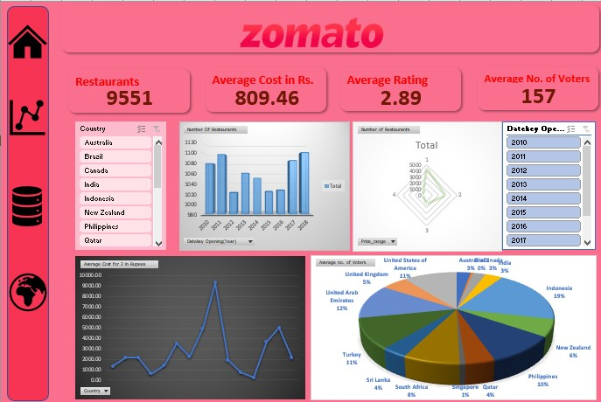
dashboard

Slide 15
conclusion
Strategic Market Entry: Focus on Indonesia, the Philippines, and Qatar due to favorable market conditions.
Key Selection Criteria: High average ratings, robust market demand, and higher spending capacity.
Operational Excellence: Emphasize quality, premium pricing, and diverse culinary offerings.
Data-Driven Decisions: Regularly monitor market trends and customer feedback to adapt strategies.
Focus on Dine-In: Prioritize the in-restaurant experience over online delivery, except in markets with strong demand for delivery services.
Local Adaptation: Customize offerings based on local preferences and cultural sensitivities.

Slide 16
THANK YOU!

